Slide 1
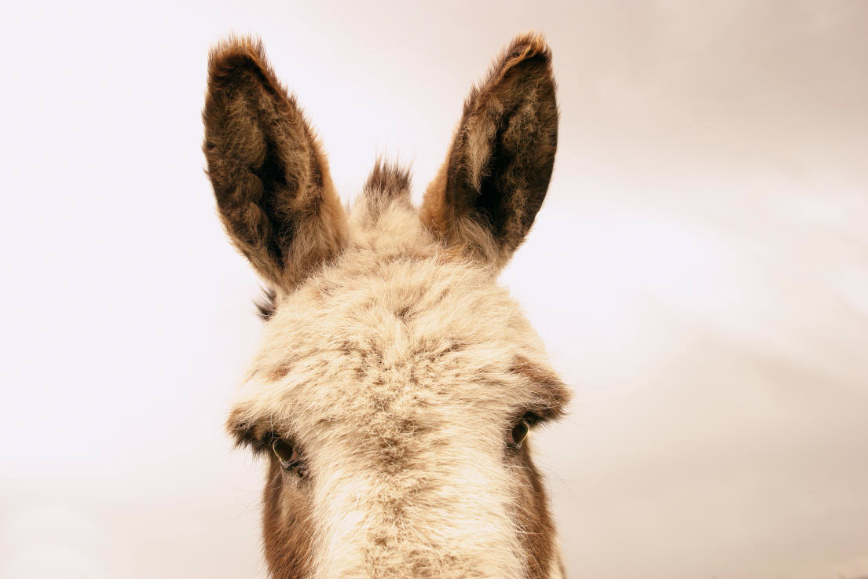
Speaking for the Ear: Adapting to Listeners
Dr. Jeffrey Arthurs, Gordon-Conwell Theological Seminary,
as taught at Singapore Bible College DMin module, March 2016
and offered for free download by Dr. Rick Griffith at BibleStudyDownloads.org

Slide 2
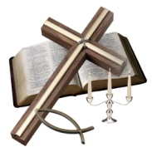

2 Timothy 4:1-2
In the presence of God and of Christ Jesus, who will judge the living and the dead, and in view of his appearing and his kingdom, I give you this charge: Preach the Word; be prepared in season and out of season; correct, rebuke, and encourage—with great patience and careful instruction.

Slide 3
Speaking for the Ear: Adapting to Listeners

Slide 4
The Power of Clarity
“There is no better way to make a good cause prevail than to make it plain.”
Richard Baxter, cited in “Preaching with a Pastor’s Heart,” Preach the Word (Wheaton: Crossway, 2007), 128.

Slide 5
Contrast Written and Oral Communication

Slide 6
How to Speak to Help Listeners Listen
Restate key ideas.

Slide 7
Redundancy Necessary in Oral Communication
“The oral utterance has vanished as soon as it is uttered. Hence the [speaker] must move ahead more slowly, keeping close to the focus of attention much of what it has already dealt with. Redundancy, repetition of the just-said, keeps both speaker and hearer on the track.”
  Walter Ong, Orality and Literacy (New York: Methuen,, 1982), 39.

Slide 8

Restatement uses the principles of focus and redundancy to make a point clear. Until the preacher restates . . . the words of the text tend to blend together in the listeners’ minds . . . . Restatement would seem simplistic and redundant in a written document, but experienced preachers recognize that repetition is one of the most powerful communication tools. Since a listener (unlike a reader) cannot review what has preceded, repetition underlines what the preacher wants most to impress on others’ minds.
Bryan Chapell, Christ-Centered Preaching, 118.

Slide 9
Key Sentences that need restatement:
Big Idea.
Main points (Roman numerals).
Structural statements such as transitions and preview.
Anything else that you want to emphasize.

Slide 10

Restatement of a Main Idea
Jesus says that worry is a sin.
He says that fussing and fretting is wrong.
Jesus tells us that anxiety over things we can’t control is not his way, not the way of his disciples.
He says that worry is sin.

Slide 11
You Try It:
Restate this big idea:
God created us to be worshippers.
Identify key terms.
Think of synonyms for those key terms.
Restate the Big Idea three times using those synonyms.

Slide 12
You try it.
Restate this big idea:
Because the Bible is the Word of God, we listen.
Groups of 2. Introduce yourselves.
Identify key terms.
Think of synonyms for those terms.
Restate at least three times. Speak aloud.

Slide 13
Example of Restatement:
Preview of main pts.
Don Sunukjian, “The Shortest Distance is a Zigzag”
First, I want you to see that God deliberately leads us on a zigzag path. There are times when intentionally, knowingly, purposefully he will take our lives in an alternate route. I want you to see that he does it deliberately.
I want you to see why he does it: what’s his purpose; what’s accomplished by it?
And then finally, how does he keep us encouraged. In the midst of the zigs and the zags, when we don’t see any progress, how does God keep us sustained on the way? What promises keep us moving in that direction?

Slide 14
Example of Restatement:
Transition
Rick Warren
“Why is the World So Messed Up?”

Slide 15
Rick Warren, “Why is the World So Messed Up?
Now here’s the question I’ve got: why doesn’t God just shut the Earth down?
When he looks down and sees genocide and suicide and war and rape and murder and people hating each other, people cheating on each other, and people being mean, why doesn’t he just pull the plug on the planet? Why does he put up with it? He’s got the power to shut it all down. Why doesn’t God just close up shop? Why is he allowing a broken planet to limp along for a little bit longer?

Slide 16
John MacArthur, “Fifteen Words of Hope.”
But then the question comes up, How can that be? How can such a reconciliation take place? How can an absolutely and utterly holy God who is infinitely pure and perfect ever be reconciled to sinners? How can he do that, who is too pure to look on sin or to fellowship with transgressors? How can God satisfy his just and holy law with a condemnation of sinners by full and deserved punishment, and still show them mercy who deserve no mercy?

Slide 17
How can God end the hostility and how can he take sinners into his holy heaven to live with him forever in intimate communion? How? How can both justice and grace be satisfied? How can love toward sinners and righteousness come together? To put it in Paul’s words, “How can God be just and a justifier of sinners?” The one verse I just read you explains how.

Slide 18
You try it.
Use restatement in a transition:
“The verse says that Jesus is the ‘Great High Priest.’ We’ve seen what that metaphor means, but now let’s go further.
What difference does it make?
Groups of 2 (change partners and introduce yourselves).
Restate at least three times.
Speak aloud.

Slide 19
You Try It:
Restate this Preview of Main Points:
This passage will show us that he created us to worship with our words and our deeds.
Same groups of 2.
Identify key terms.
Think of synonyms for those key terms.
Restate at least three times using those synonyms.
Each person will speak aloud.

Slide 20
Example of Restatement: Key Idea (We all experience hopelessness).
Dr. Tony Evans
“God is Up to Something Great”

Slide 21
Tony Evans, “God is Up to Something Great.”
Repetition of word “hopelessness.”
Use of images and examples to define.
Prompting of affect as well as cognition.
Rhythm.

Slide 22
How to Speak to Help Listeners Listen
Restate key ideas.
If your points are a list, use the same word each time you introduce a new point.

Slide 23
DON’T:
Transition: Why does the grace of God turn up the heat?
    Our sin.
    God’s glory demands it.
    When discipline comes.
  Notice: the transition (“why does the grace of God . . .”) implies that the following material will answer the question “why?” The listeners expect that you will provide reasons. Therefore, your main points should use the key term “reason.”

Slide 24

DO:
Why does the grace of God turn up the heat?
  One reason God turns up the heat is because our sin demands it.
  A second reason God turns up the heat is because he is jealous for his own glory.
  A third reason God turns up the heat is to produce the “peaceful fruit of righteousness.”
    Repentance
    Praise

Slide 25
How to Speak to Help Listeners Listen
Restate key ideas.
If your points are a list, use the same word each time your introduce a new point.
Begin complicated sequences with a summary.

Slide 26
Class Exercise:
The Curse of Knowledge
Guess the song Dr. Arthurs taps.
This was an actual study done by a PhD student in 1990 (Elizabeth Newton, Stanford).
She asked the tappers how many guessers would get the song right, and they predicted 50%, but of the 120 songs tapped, guessers identified only 2.5% (3 out of 120).
Newton was actually studying the tappers, not the guessers. She studied how they became frustrated.
Applications for homiletics?

Slide 27
How to Speak to Help Listeners Listen
Restate key ideas.
If your points are a list, use the same word each time your introduce a new point.
Begin complicated sequences with a summary.
Use your voice and body to clarify ideas.

Slide 28
You try it:
Use your body to communicate this idea:
(Gesture) When God calls us, He empowers us, and He sends us.
(Movement) So far we’ve seen that God calls and empowers disciples. Now let’s move on to look at the end product: He sends us. God wants to send you.

Slide 29
You try it:
Use your voice (pause) to clarify these ideas
Why did God strike down Uzzah, poor old Uzzah? All he did was steady the ark. It was falling, so Uzzah reacted. He reached out and caught it. What’s so bad about that?
Is God petty / fickle / mean? //
Why did God strike Uzzah? ///
I’d like to suggest an answer by looking at two factors behind Uzzah’s action . . .

Slide 30
Delivery That Helps Listeners Listen
Dr. Arthurs: conclusion of a sermon from Psalm 32, “Cover or Be Covered.” 34:02
Gestures, Pause, Eye contact, Facial Expression, etc.

Slide 31
How to Speak to Help Listeners Listen
Restate key ideas.
If your points are a list, use the same word each time your introduce a new point.
Begin complicated sequences with a summary.
Use your voice and body to clarify ideas.
Maintain attention.

Slide 32
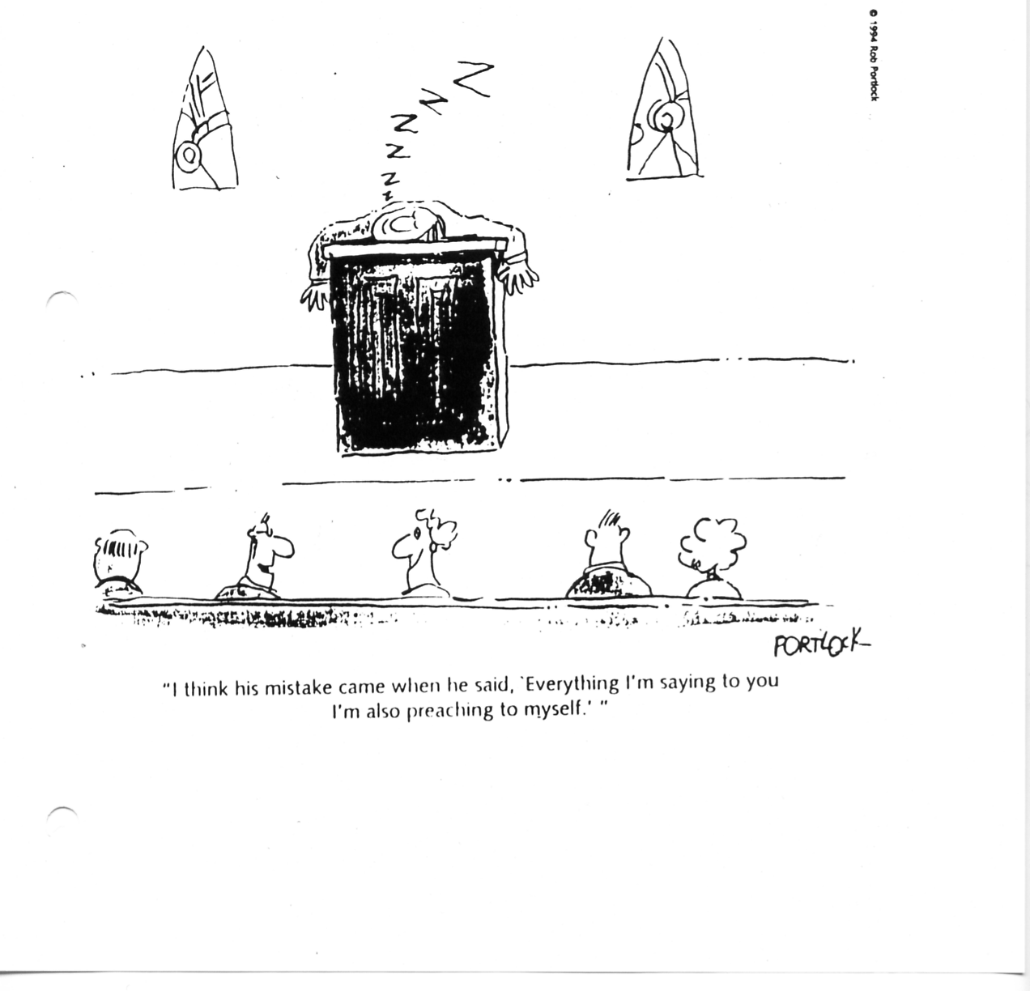
"I think his mistake came when he said, 'Everything I'm saying to you I'm also preaching to myself.'"

Slide 33
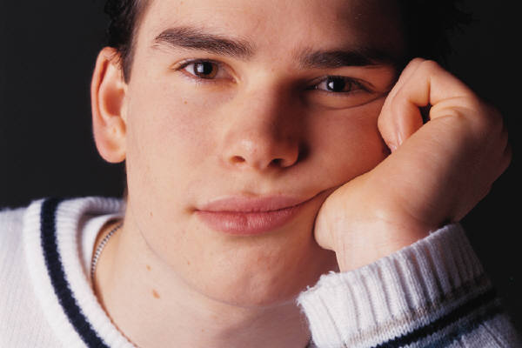
Boredom is a form of evil . . . boredom is a preview of death if not a form of death, and when trapped in prolonged boredom, even the most saintly of us will hope for, pray for, or even engineer relief, however demonic.
Fred Craddock

Slide 34

Sin cannot be taken out of men as Eve was taken out of the side of Adam while they lay fast asleep. They must be awake, understanding what we are saying, and feeling its force, or else we may as well go to sleep too.”
C.H. Spurgeon

Slide 35
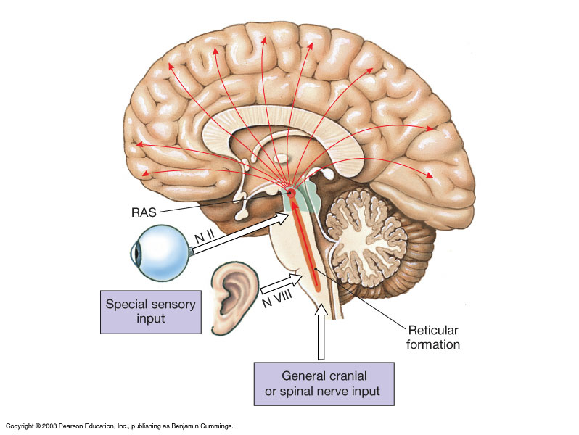
RAS (Reticular Activating System)
What does the RAS allow into consciousness?
Concrete

Slide 36
The boy is sad.

Slide 37
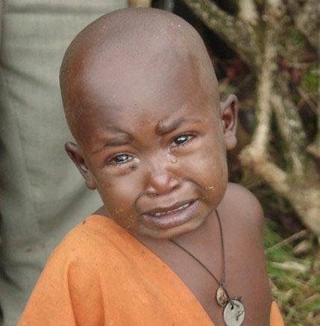
http://www.hhi.org/images/photos/boy-crying.jpg

Slide 38
RAS (Reticular Activating System)
What does the RAS allow into consciousness?
Concrete
Unusual
Threatening
Valuable

Slide 39
Review:
How to Speak to Help Listeners Listen
Restate key ideas.
If your points are a list, use the same word each time your introduce a new point.
Begin complicated sequences with a summary.
Use your voice and body to clarify ideas.
Maintain attention.

Slide 40
2 Timothy 4:1-2
In the presence of God and of Christ Jesus, who will judge the living and the dead, and in view of his appearing and his kingdom, I give you this charge: Preach the Word; be prepared in season and out of season; correct, rebuke, and encourage—with great patience and careful instruction.

Slide 41
Black

Slide 42


Preaching (Homiletics) link at BibleStudyDownloads.org
Get this presentation for free!
Notes:
Preaching (pr)
Homiletics

